Slide 1


Neutral Concepts Approach

Slide 2

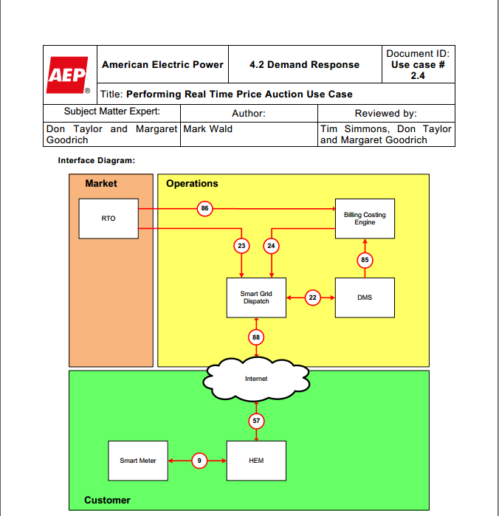
Mapping Use Case Terms
Let’s look at this term
2016 Copyright © SGIP, Inc. CONFIDENTIAL. ALL RIGHTS RESERVED Page 2

Slide 3
The HEM in the AEP/EPRI use case
HEM stands for “Home Energy Management System”
What does that really mean?
Home Energy Management System
=
A piece of hardware and/or software
(an Actor)
…that performs a set of Services
2016 Copyright © SGIP, Inc. CONFIDENTIAL. ALL RIGHTS RESERVED Page 3

Slide 4
The HEM in the AEP/EPRI use case
A piece of hardware and/or software
(an Actor)
There are different kinds of hardware.
What kind of hardware?
There are different grades of hardware.
Sensor hardware
Industrial grade
Actuator hardware
Commercial grade
Control hardware
Residential grade
2016 Copyright © SGIP, Inc. CONFIDENTIAL. ALL RIGHTS RESERVED Page 4

Slide 5
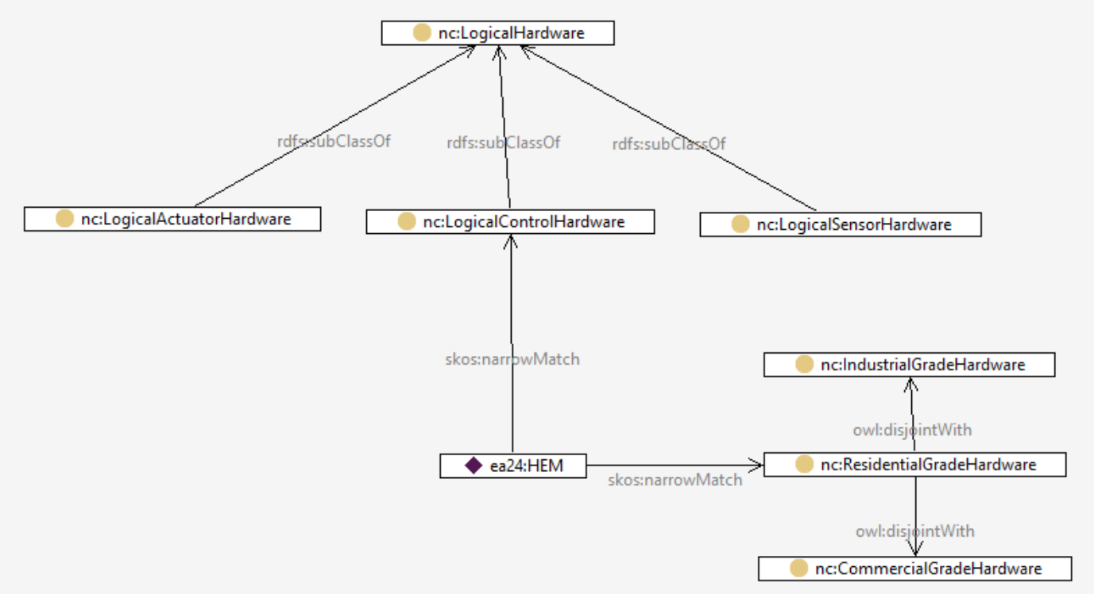
The HEM in the AEP/EPRI use case
2016 Copyright © SGIP, Inc. CONFIDENTIAL. ALL RIGHTS RESERVED Page 5

Slide 6
The HEM in the AEP/EPRI use case
OK, we have characterized the hardware.
What about the Services it performs?
Home Energy Management System
=
A piece of hardware and/or software
(an Actor)
…that performs a set of Services
2016 Copyright © SGIP, Inc. CONFIDENTIAL. ALL RIGHTS RESERVED Page 6

Slide 7
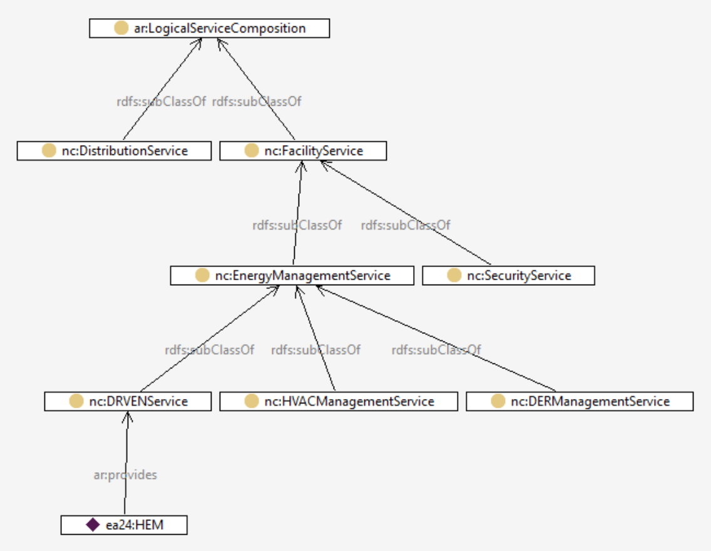
The HEM in the AEP/EPRI use case
Services
We can define a hierarchy of Services
For this DR use case, we know the HEM provides at least a DR service
2016 Copyright © SGIP, Inc. CONFIDENTIAL. ALL RIGHTS RESERVED Page 7

Slide 8
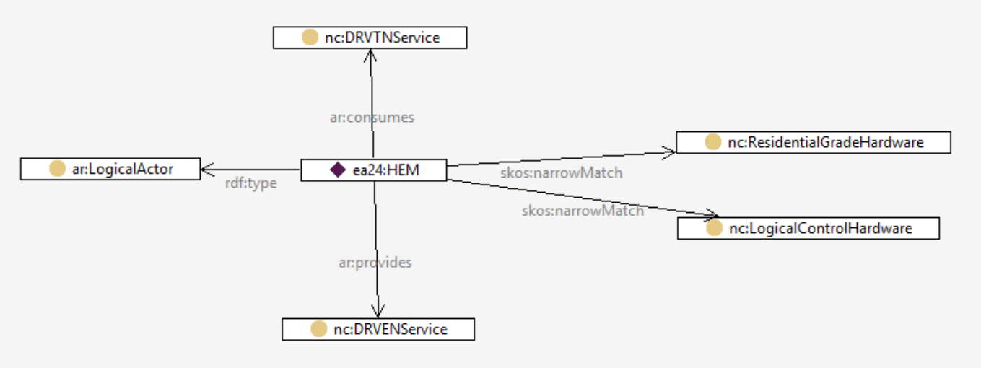
The HEM in the AEP/EPRI use case
Definition of HEM
So, a definition of the HEM in this use case might be captured as follows:
2016 Copyright © SGIP, Inc. CONFIDENTIAL. ALL RIGHTS RESERVED Page 8

Slide 9
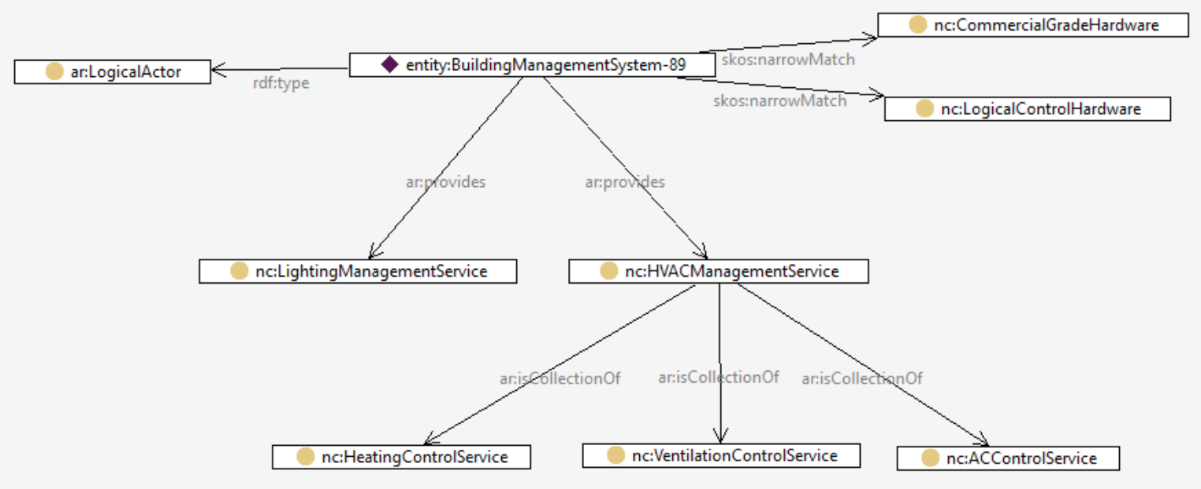
“BuildingManagementSystem”
Definition from the EU
A system consisting of several decentralized controllers and a centralized management system to monitor and control the heating, ventilation, air conditioning, light and other facilities within a building.
2016 Copyright © SGIP, Inc. CONFIDENTIAL. ALL RIGHTS RESERVED Page 9

Slide 10
“BuildingManagementSystem”
How does this help? Because if you want to interface with something that provides HVACManagementService, then you are guaranteed that it can perform HeatingControlService (for example).
2016 Copyright © SGIP, Inc. CONFIDENTIAL. ALL RIGHTS RESERVED Page 10

Slide 11
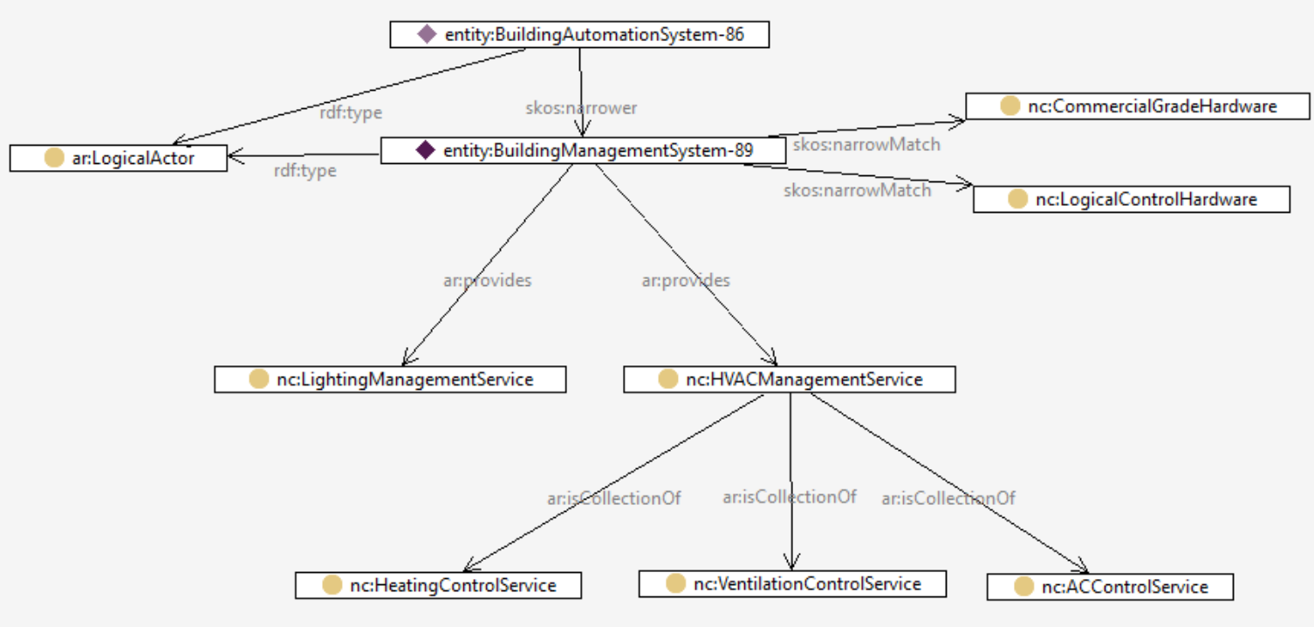
“BuildingAutomationSystem”
…and BuildingAutomationSystem can do everything BuildingManagementSystem can do because of the skos:narrower relation.
Actor (from CSWG NISTIR 7628)
Actor (from TC8 WG6)
2016 Copyright © SGIP, Inc. CONFIDENTIAL. ALL RIGHTS RESERVED Page 11

Slide 12
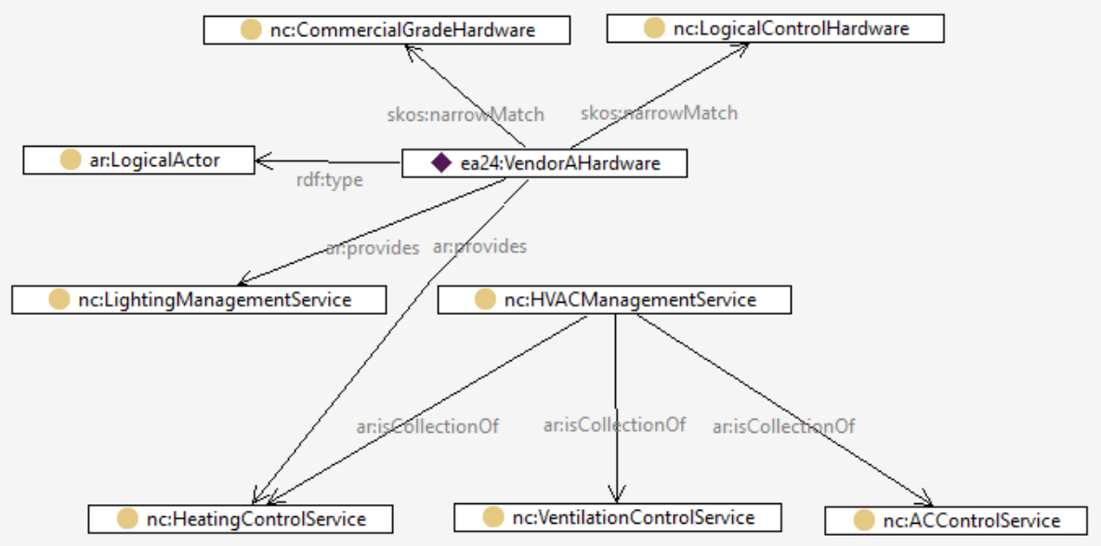
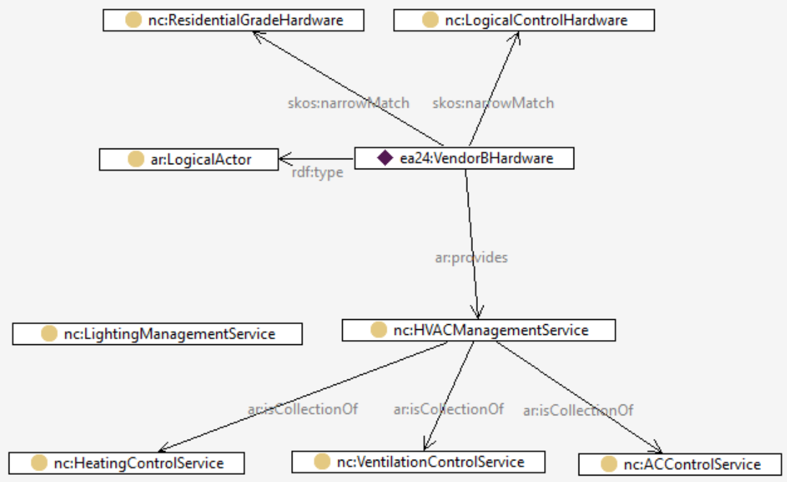
Implications
If we correctly categorize systems and services, we can begin to identify where interoperability is possible, and where there will be problems.
Vendor B
Insert Vendor A and Vendor B
Vendor A
2016 Copyright © SGIP, Inc. CONFIDENTIAL. ALL RIGHTS RESERVED Page 12

